Slide 1
Final Research Presentation
Team: Feed Mid
Mengyao cai

Slide 2
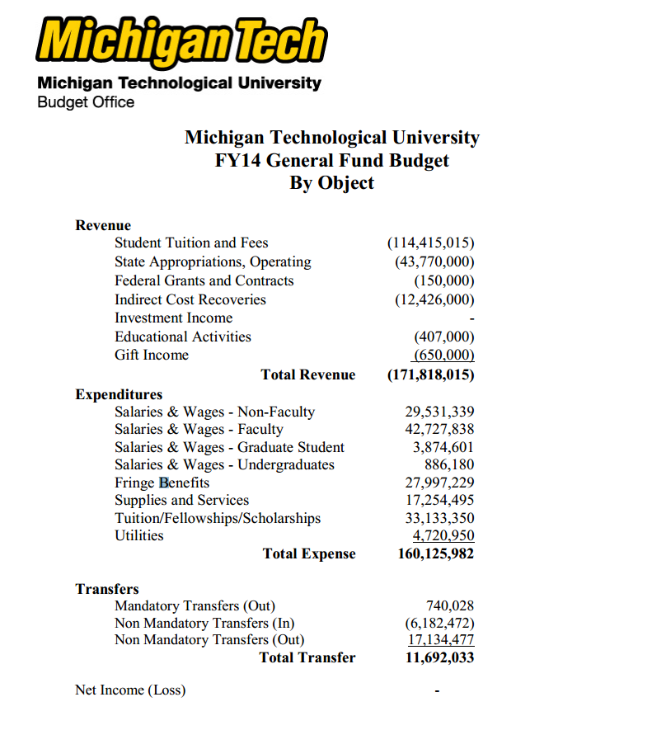
Our Budget
$160,125,982 * 5% = $8,006,299.1
8 millions dollar cap

Slide 3
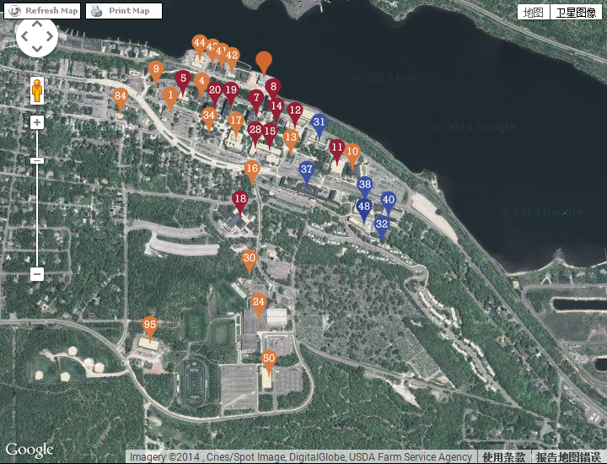
Campus Map
Red: Academic building
Blue: Residence Building
Orange: Other building

Slide 4
Entrance Room
11 Academic Buildings
6 Residence Buildings
18 Other Buildings
Estimate 2 entrances every building
Equals 8 doors
Total 320 doors
$2,5000 per door

Slide 5
Thank You
Any question?

